Slide 1
Cryptocurrency market data analysis project
— By Dongyue Xu

Slide 2
Analyzing the correlations among Fear and Greed Index, Bitcoin Price, and the S&P Cryptocurrency Broad Digital Asset Index
Project Topic

Slide 3
Introduction
This project is to analyze the correlations among Fear and Greed Index, Bitcoin Price, and the S&P Cryptocurrency Broad Digital Asset (BDA) Index in the cryptocurrency market.
In particular, the S&P Cryptocurrency Broad Digital Asset (BDA) Index is the cryptocurrency market benchmark index. This benchmark index is designed to track the performance of a wide range of investable digital assets that meet specific liquidity and market capitalization criteria.

Slide 4
The Fear and Greed Index measures cryptocurrency market sentiment. It uses a combination of social signals and market trends to determine the overall sentiment of crypto investors. This index ranges from 0 to 100, where a lower value indicates extreme fear, and a higher value indicates extreme greed. This index provides insights into whether the market may be undervalued or overvalued.

Slide 5
Data Sources
Data source # | Name / short description | Source URL | Type | List of fields | Format | Data size, number of data points you plan to use
1 | Crypto Fear and Greed Index | https://coinmarketcap.com/charts/fear-and-greed-index/ | API | Value, Date | json | 554
2 | Bitcoin Prices | https://coinmarketcap.com/api/documentation/v1/#operation/getV2CryptocurrencyOhlcvHistorical | API | Value, Timestamp | json | 554
3 | BDA Index | https://www.spglobal.com/spdji/en/indices/digital-assets/sp-cryptocurrency-broad-digital-asset-bda-index/#overview | File | Value, Date | xlsx | 396

Slide 6
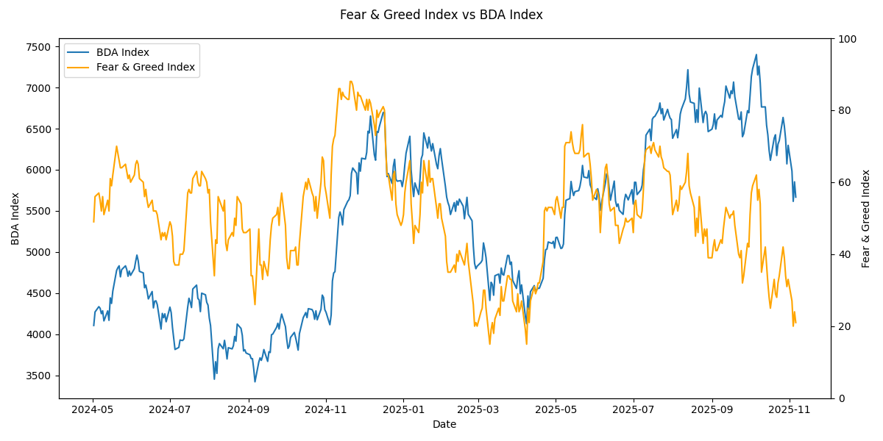

Slide 7
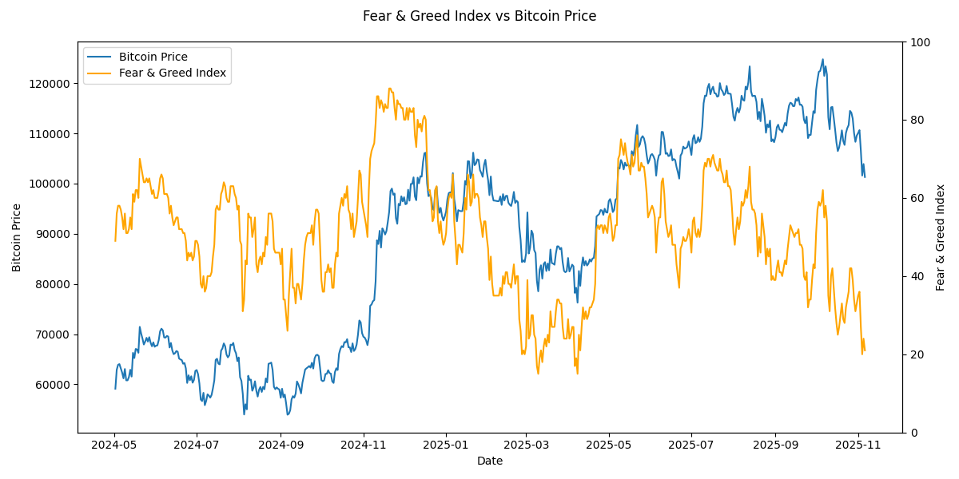

Slide 8
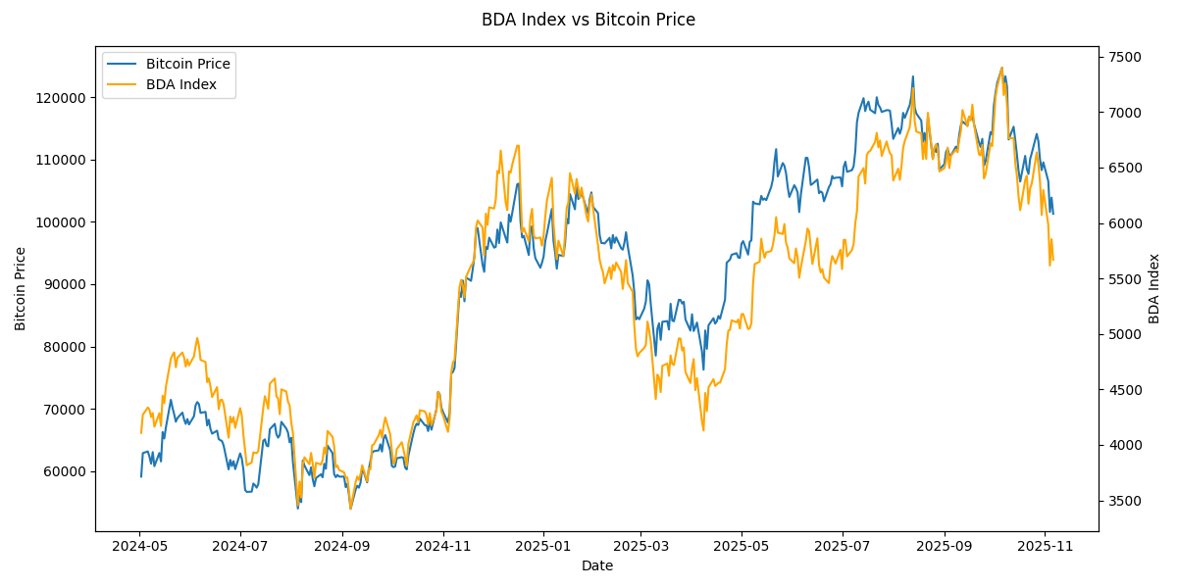

Slide 9
Challenges
Since Fear and Greed Index is bounded, while BDA Index and BTC Price are unbounded and trending upward over time, I calculated daily log returns of BDA Index and Bitcoin Price in order to calculate the correlation coefficient between Fear and Greed Index and BDA Index and the correlation coefficient between Fear and Greed Index and Bitcoin Price.
For Fear and Greed Index, I used both approaches: daily returns and differences.

Slide 10
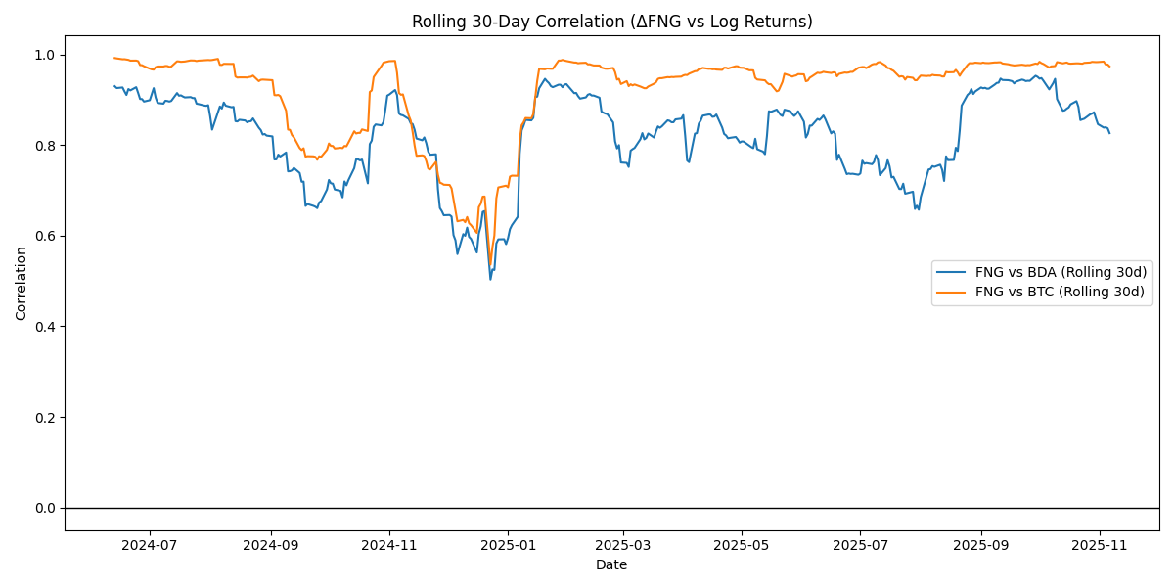

Slide 11
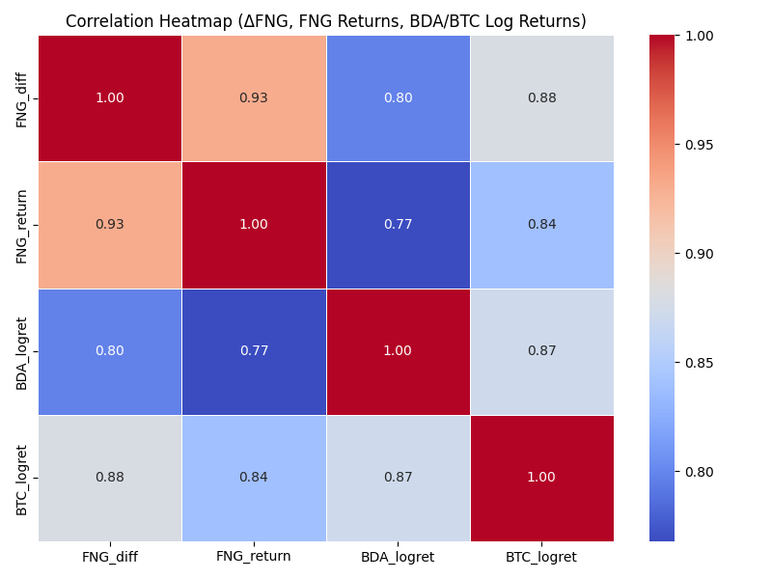

Slide 12
Summary of results
Correlation ΔFNG vs BDA Log Returns: 0.7974
Correlation ΔFNG vs BTC Log Returns: 0.8791
Correlation FNG Returns vs BDA Log Returns: 0.7679
Correlation FNG Returns vs BTC Log Returns: 0.8391
Conclusions:
Fear and Greed Index has very high correlations with both Bitcoin Price and BDA Index.
Fear and Greed Index has higher correlation coefficient with Bitcoin Price compared to that with BDA Index.

Slide 13
Thank You

